Slide 1
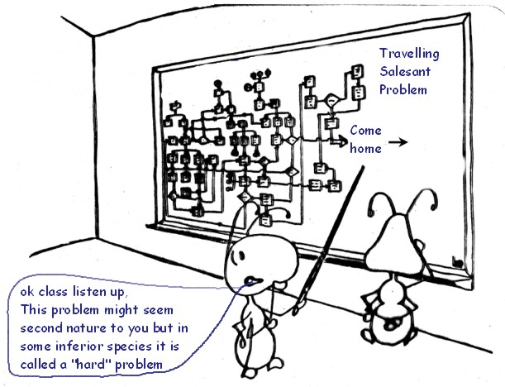
Ant Colony Optimization
Prepared by:
Ahmad Elshamli, Daniel Asmar, Fadi Elmasri

Slide 2
Presentation Outline
Section I (Introduction)
Historical Background
Ant System
Modified algorithms
Section II (Applications)
TSP
QAP
Section III (Applications +Conclusions)
NRP
VRP
Conclusions, limitations and
Danny
Fadi
Ahmad

Slide 3
Section 1
Introduction (Swarm intelligence)
Natural behavior of ants
First Algorithm: Ant System
Improvements to Ant System
Applications

Slide 4
Swarm intelligence
Collective system capable of accomplishing difficult tasks in dynamic and varied environments without any external guidance or control and with no central coordination
Achieving a collective performance which could not normally be achieved by an individual acting alone
Constituting a natural model particularly suited to distributed problem solving
http://www.scs.carleton.ca/~arpwhite/courses/95590Y/notes/SI%20Lecture%203.pdf

Slide 5
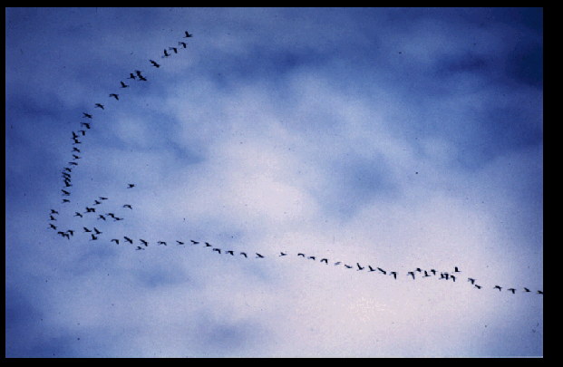
http://www.scs.carleton.ca/~arpwhite/courses/95590Y/notes/SI%20Lecture%203.pdf

Slide 6
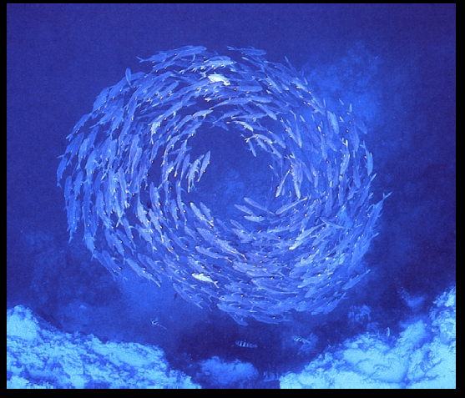
http://www.scs.carleton.ca/~arpwhite/courses/95590Y/notes/SI%20Lecture%203.pdf

Slide 7
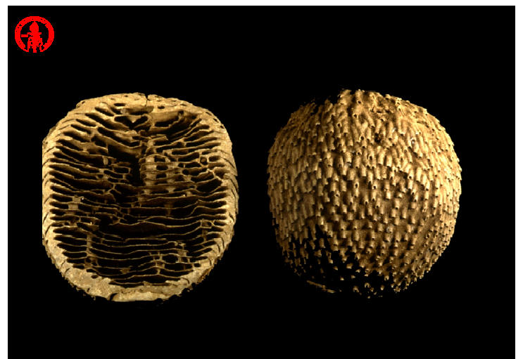
http://www.scs.carleton.ca/~arpwhite/courses/95590Y/notes/SI%20Lecture%203.pdf

Slide 8
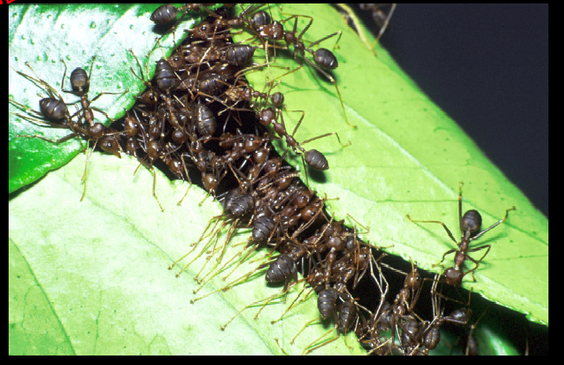
http://www.scs.carleton.ca/~arpwhite/courses/95590Y/notes/SI%20Lecture%203.pdf

Slide 9
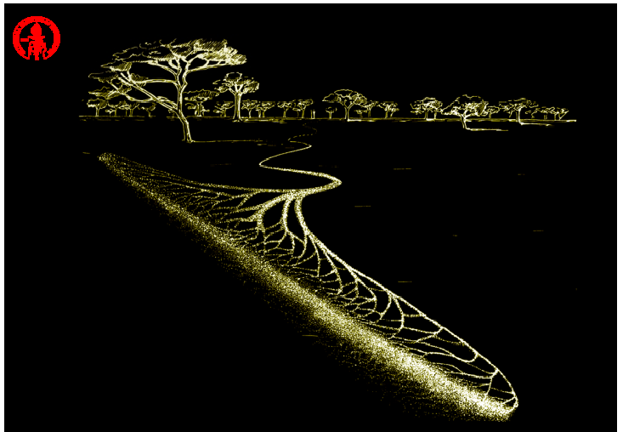
http://www.scs.carleton.ca/~arpwhite/courses/95590Y/notes/SI%20Lecture%203.pdf

Slide 10
Inherent features
Inherent parallelism
Stochastic nature
Adaptivity
Use of positive feedback
Autocatalytic in nature

Slide 11
Natural behavior of an ant
Foraging modes
Wander mode
Search mode
Return mode
Attracted mode
Trace mode
Carry mode

Slide 12

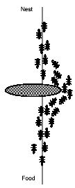


Natural behavior of ant
Ant Algorithms – (P.Koumoutsakos – based on notes L. Gamberdella (www.idsia.ch)

Slide 13
Work to date
Problem name | Authors | Algorithm name | Year
Traveling salesman | Dorigo, Maniezzo & Colorni | AS | 1991
 | Gamberdella & Dorigo | Ant-Q | 1995
 | Dorigo & Gamberdella | ACS &ACS 3 opt | 1996
 | Stutzle & Hoos | MMAS | 1997
 | Bullnheimer, Hartl & Strauss | AS_{rank} | 1997
 | Cordon, et al. | BWAS | 2000
Quadratic assignment | Maniezzo, Colorni & Dorigo | AS-QAP | 1994
 | Gamberdella, Taillard & Dorigo | HAS-QAP | 1997
 | Stutzle & Hoos | MMAS-QAP | 1998
 | Maniezzo | ANTS-QAP | 1999
 | Maniezzo & Colorni | AS-QAP | 1994
Scheduling problems | Colorni, Dorigo & Maniezzo | AS-JSP | 1997
 | Stutzle | AS-SMTTP | 1999
 | Barker et al | ACS-SMTTP | 1999
 | den Besten, Stutzle & Dorigo | ACS-SMTWTP | 2000
 | Merkle, Middenderf & Schmeck | ACO-RCPS | 1997
Vehicle routing | Bullnheimer, Hartl & Strauss | AS-VRP | 1999
 | Gamberdella, Taillard & Agazzi | HAS-VRP | 1999

Slide 14
Work to date
Problem name | Authors | Algorithm name | Year
Connection-oriented | Schoonderwood et al. | ABC | 1996
network routing | White, Pagurek & Oppacher | ASGA | 1998
 | Di Caro & Dorigo | AntNet-FS | 1998
 | Bonabeau et al. | ABC-smart ants | 1998
Connection-less | Di Caro & Dorigo | AntNet & AntNet-FA | 1997
network routing | Subramanian, Druschel & Chen | Regular ants | 1997
 | Heusse et al. | CAF | 1998
 | van der Put & Rethkrantz | ABC-backward | 1998
Sequential ordering | Gamberdella& Dorigo | HAS-SOP | 1997
Graph coloring | Costa & Hertz | ANTCOL | 1997
Shortest common supersequence | Michel & Middendorf | AS_SCS | 1998
Frequency assignment | Maniezzo & Carbonaro | ANTS-FAP | 1998
Generalized assignment | Ramalhinho Lourenco & Serra | MMAS-GAP | 1998
Multiple knapsack | Leguizamon & Michalewicz | AS-MKP | 1999
Optical networks routing | Navarro Varela & Sinclair | ACO-VWP | 1999
Redundancy allocation | Liang & Smith | ACO-RAP | 1999
Constraint satisfaction | Solnon | Ant-P-solver | 2000

Slide 15
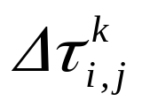
How to implement in a program
Ants: Simple computer agents
Move ant: Pick next component in the const. solution
Pheromone:
Memory: M_{K} or Tabu_{K}
Next move: Use probability to move ant

Slide 16

A simple TSP example
[]
1
[]
A
B
2
[]
C
3
[]
4
D
E
[]
d_{AB} =100;d_{BC} = 60…;d_{DE} =150
5

Slide 17
Iteration 1
[A]
[B]
1
A
2
B
[C]
3
C
[D]
[E]
D
5
4
E

Slide 18
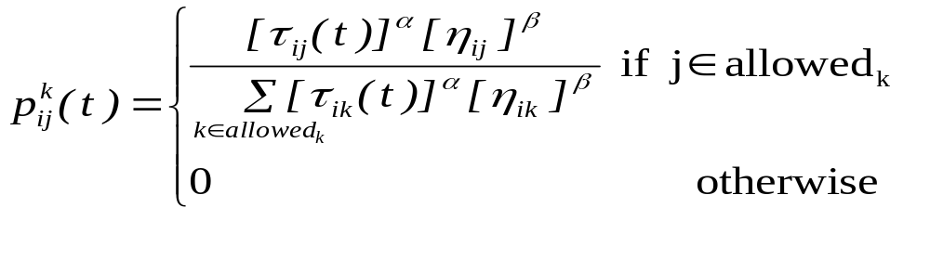
How to build next sub-solution?
[A]
1
A
B
[A]
1
[A]
C
1
[A,D]
[A]
1
1
D
E

Slide 19
Iteration 2
[E,A]
[C,B]
5
A
3
B
[B,C]
2
C
[A,D]
[D,E]
1
D
4
E

Slide 20
Iteration 3
[D,E,A]
[E,A,B]
4
5
A
B
[A,D,C]
1
C
[B,C,D]
[C,B,E]
2
D
3
E

Slide 21
Iteration 4
[B,C,D,A]
[D,E,A,B]
2
A
4
B
[E,A,B,C]
5
C
[C,B,E,D]
[A,DCE]
D
3
1
E

Slide 22
Iteration 5
[C,B,E,D,A]
[A,D,C,E,B]
3
1
A
B
[D,E,A,B,C]
4
C
[E,A,B,C,D]
[B,C,D,A,E]
D
5
E
2

Slide 23
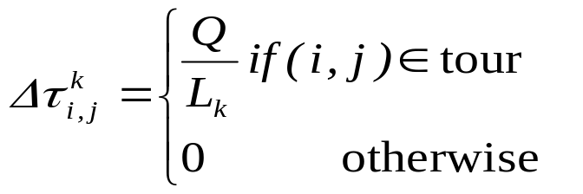
Path and Pheromone Evaluation
[A,D,C,E,B]
L₁ =300
1
[B,C,D,A,E]
L₂ =450
2
[C,B,E,D,A]
L₃ =260
3
[D,E,A,B,C]
L₄ =280
4
[E,A,B,C,D]
L₅ =420
5

Slide 24
End of First Run
Save Best Tour (Sequence and length)
All ants die
New ants are born

Slide 25

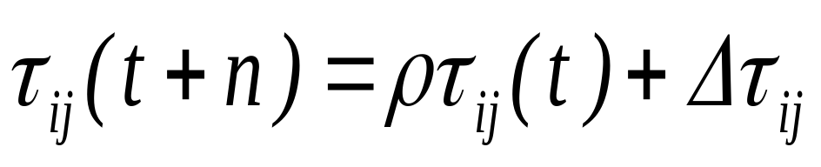
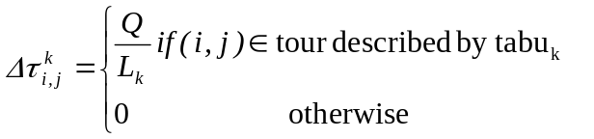
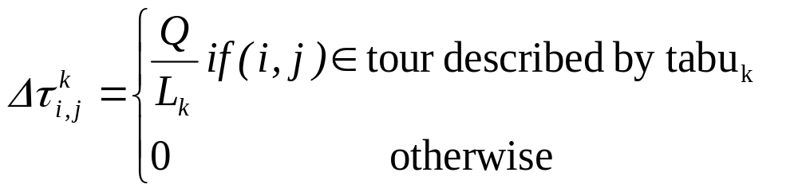

Ant System (Ant Cycle) Dorigo [1] 1991
t = 0; NC = 0; τ_{ij}(t)=c for ∆τ_{ij}=0
Place the m ants on the n nodes
Initialize
Update tabu_{k}(s)
Tabu list management
Choose the city j to move to. Use probability
Move k-th ant to town j. Insert town j in tabu_{k}(s)
Compute the length L_{k} of every ant
Update the shortest tour found
=
For every edge (i,j)
Compute
For k:=1 to m do
Yes
Yes
NC<NC_{max}
&& not stagn.
Set t = t + n; NC=NC+1; ∆τ_{ij}=0
No
End

Slide 26
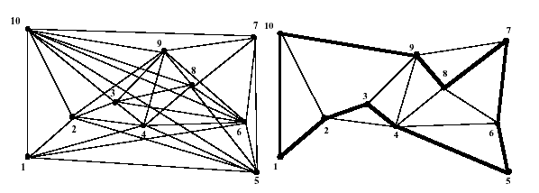
Stopping Criteria
Stagnation
Max Iterations

Slide 27
General ACO
A stochastic construction procedure
Probabilistically build a solution
Iteratively adding solution components to partial solutions
- Heuristic information
- Pheromone trail
Reinforcement Learning reminiscence
Modify the problem representation at each iteration

Slide 28
General ACO
Ants work concurrently and independently
Collective interaction via indirect communication leads to good solutions

Slide 29
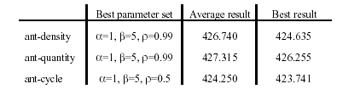
Variations of Ant System
Ant Cycle (O(NC.n³)
Ant Density (Quantity Q)
Ant Quantity (Quantity Q/d_{ij})
Taken from Dorigo [1]

Slide 30
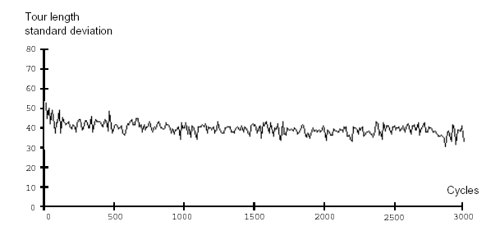
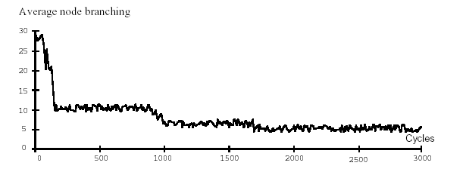
Basic Analysis
Taken from Dorigo [1]

Slide 31
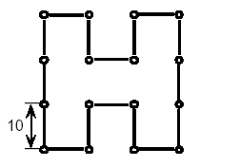
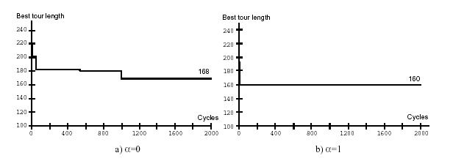
Basic Analysis
Taken from Dorigo [1]

Slide 32
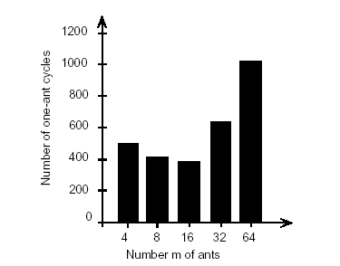
Optimal number of ants for AS
Taken from Dorigo [1]

Slide 33
Versatility
Application to ATSP is straightforward
No modification of the basic algorithm

Slide 34
Some inherent advantages
Positive Feedback accounts for rapid discovery of good solutions
Distributed computation avoids premature convergence
The greedy heuristic helps find acceptable solution in the early solution in the early stages of the search process.
The collective interaction of a population of agents.

Slide 35
Disadvantages in Ant Systems
Slower convergence than other Heuristics
Performed poorly for TSP problems larger than 75 cities.
No centralized processor to guide the AS towards good solutions

Slide 36
Improvements to AS
Daemon actions are used to apply centralized actions
  Local optimization procedure
  Bias the search process from global information

Slide 37
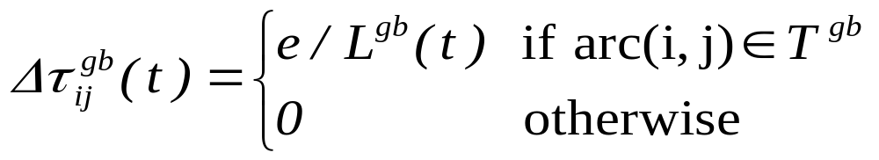
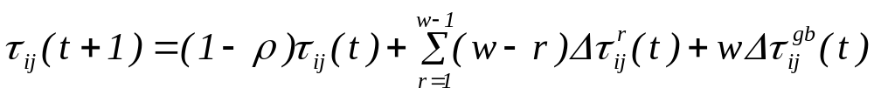
Improvements to AS
Elitist strategy
AS_{rank}

Slide 38
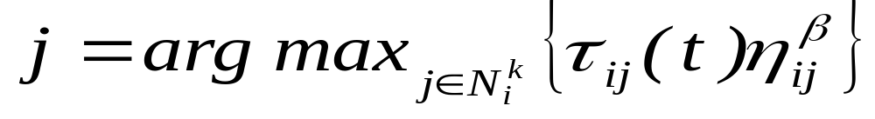
Improvements to AS
ACS
  Strong elitist strategy
  Pseudo-random proportional rule
With Probability q₀:
With Probability (1- q₀):

Slide 39
Improvements to AS
ACS (Pheromone update)
  Update pheromone trail while building the solution
  Ants eat pheromone on the trail
  Local search added before pheromone update

Slide 40
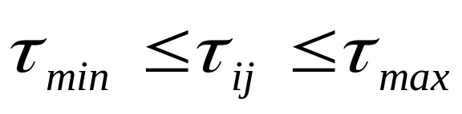
Improvements to AS
MMAS
  High exploration at the beginning
  Only best ant can add pheromone
  Sometimes uses local search to improve its performance

Slide 41
Dynamic Optimization Problems
ABC (circuit switched networks)
AntNet (routing in packet-switched networks)

Slide 42
Applications
Traveling Salesman Problem
Quadratic Assignment Problem
Network Model Problem
Vehicle routing

Slide 43
Section II
Traveling Salesman Problem
Quadrature Assignment Problem
Mr. Fadi Elmasri

Slide 44
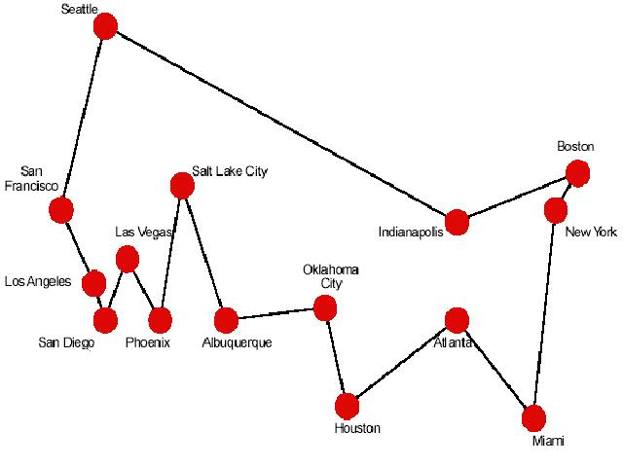
Travelling Salesman Problem (TSP)
TSP PROBLEM : Given N cities, and a distance function d between cities, find a tour that:
1. Goes through every city once and only once
2. Minimizes the total distance.
Problem is NP-hard
Classical combinatorial
optimization problem to
test.

Slide 45
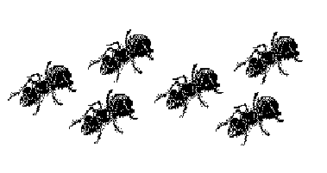
ACO for the Traveling Salesman Problem
The TSP is a very important problem in the context of Ant Colony Optimization because it is the problem to which the original AS was first applied, and it has later often been used as a benchmark to test a new idea and algorithmic variants.
The TSP was chosen for many reasons:
It is a problem to which the ant colony metaphor
It is one of the most studied NP-hard problems in the combinatorial optimization
it is very easily to explain. So that the algorithm behavior is not obscured by too many technicalities.

Slide 46
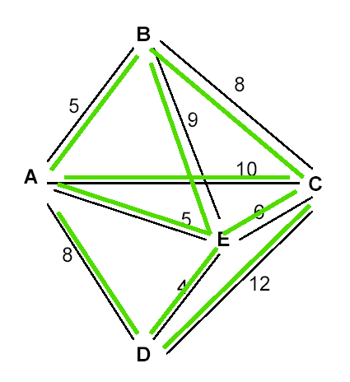
Search Space
Discrete Graph
To each edge is associated a static value
returned by an heuristic function η (r,s)
based on the edge-cost
Each edge of the graph is augmented with a pheromone trail τ (r,s) deposited by ants.
Pheromone is dynamic and it is learned at run-ime

Slide 47
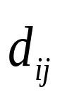


Ant Systems (AS)
Ant Systems for TSP
Graph (N,E): where N = cities/nodes, E = edges
= the tour cost from city i to city j (edge weight)
Ant move from one city i to the next j with some transition probability.
B
A
D
C

Slide 48
Ant Systems Algorithm for TSP
Initialize
Place each ant in a randomly chosen city
For Each Ant
Choose NextCity(For Each Ant)
yes
more cities
to visit
No
Return to the initial cities
Update pheromone level using the tour cost for each ant
No
Stopping
criteria
yes
Print Best tour

Slide 49


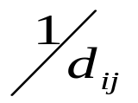
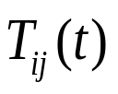
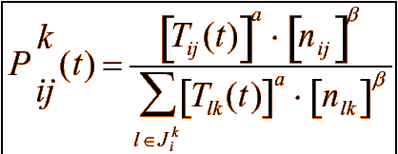
Rules for Transition Probability
1. Whether or not a city has been visited
Use of a memory(tabu list): : set of all cities that are to be visited
= visibility:Heuristic desirability of choosing city j when in city i.
3.Pheromone trail: This is a global type of information
Transition probability for ant k to go from city i to city j while building its route.
a = 0: closest cities are selected

Slide 50
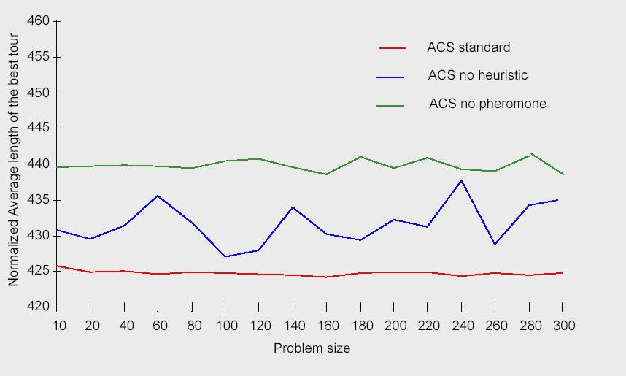
Pheromone trail and heuristic function:
are they useful?
Comparison between ACS standard, ACS with no heuristic (i.e., we set B=0), and ACS in which ants
neither sense nor deposit pheromone. Problem: Oliver30. Averaged over 30 trials, 10,000/m iterations per trial.

Slide 51
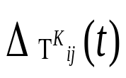
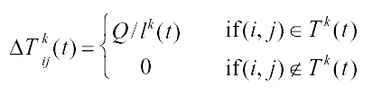

Trail pheromone in AS
After the completion of a tour, each ant lays some pheromone
for each edge that it has used. depends on how well the ant
has performed.
Trail pheromone decay =

Slide 52
Ant Colony Optimization (ACO)
Dorigo & Gambardella introduced four modifications in AS :
1.a different transition rule,
2.Local/global pheromone trail updates,
3.use of local updates of pheromone trail to favor exploration
4.a candidate list to restrict the choice of the next city to visit.

Slide 53
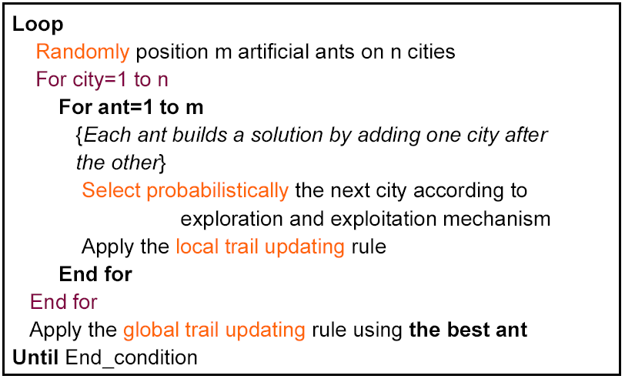
ACS : Ant Colony System for TSP

Slide 54
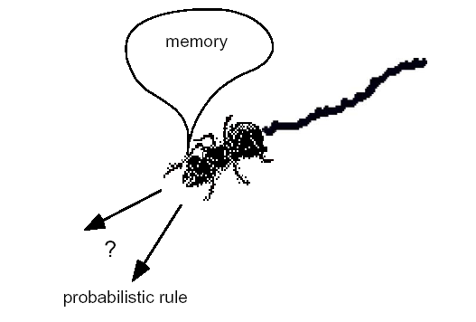
ACO State Transition Rule
Next city is chosen between the not visited cities according to a probabilistic rule
Exploitation: the best edge is chosen
Exploration: each of the edges in proportion to its value

Slide 55
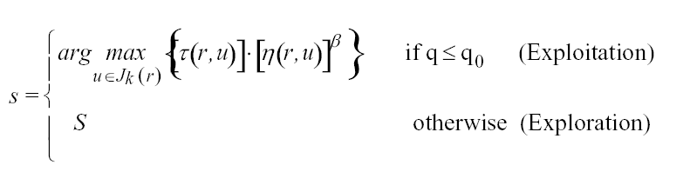
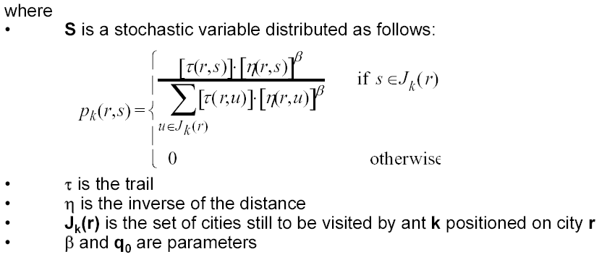
ACS State Transition Rule : Formulae

Slide 56
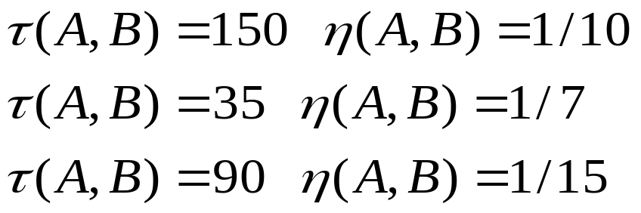
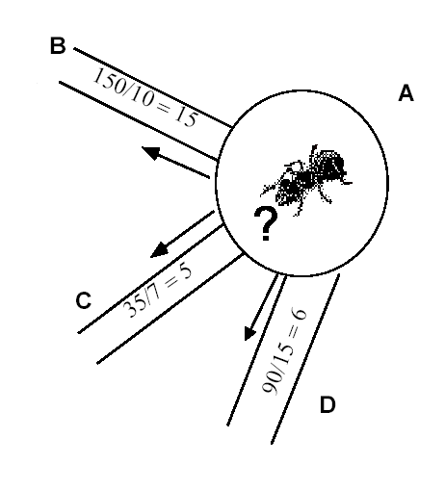
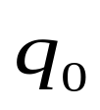
ACS State Transition Rule : example
•with probability exploitation
    (Edge AB = 15)
•with probability (1- )exploration
AB with probability 15/26
AC with probability 5/26
AD with probability 6/26

Slide 57
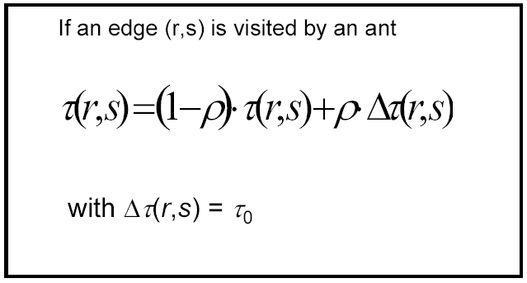
ACS Local Trail Updating
… similar to evaporation

Slide 58
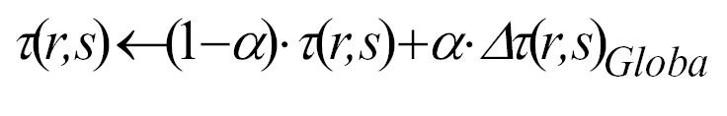
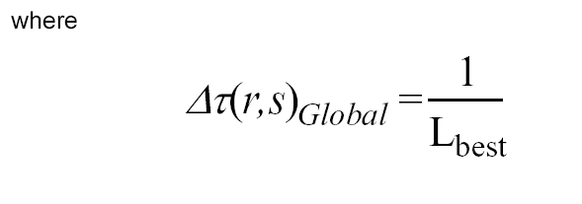
ACS Global Trail Updating
At the end of each iteration the best ant is allowed to reinforce its tour by depositing additional pheromone inversely proportional to the length of the tour

Slide 59
Effect of the Local Rule
Local rule: learnt desirability of edges changes dynamically
Local update rule makes the edge pheromone level diminish.
Visited edges are less & less attractive as they are visited by the various ants.
Favors exploration of not yet visited edges.
This helps in shuffling the
cities so that cities visited early in one ants tours are being
visited later in another ants tour.

Slide 60
ACO vs AS
Pheromone trail update
Deposit pheromone after completing a tour in AS
Here in ACO only the ant that generated the best tour from the beginning
of the trial is allowed to globally update the concentrations of pheromone
on the branches (ants search at the vicinity of the best tour so far)
In AS pheromone trail update applied to all edges
Here in ACO the global pheromone trail update is applied only to the best tour since trial began.

Slide 61
ACO : Candidate List
Use of a candidate list
A list of preferred cities to visit: instead of
examining all cities, unvisited cities are examined first.
Cities are ordered by increasing distance & list is scanned sequentially.
Choice of next city from those in the candidate list.
Other cities only if all the cities in the list have been visited.

Slide 62
Performance
• Algorithm found best solutions on small problems
(75 city)
• On larger problems converged to good solutions –
but not the best
• On “static” problems like TSP hard to beat specialist algorithms
• Ants are “dynamic” optimizers – should we even
expect good performance on static problems
• Coupling ant with local optimizers gave world
class results….

Slide 63
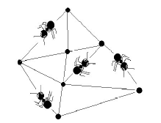
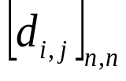




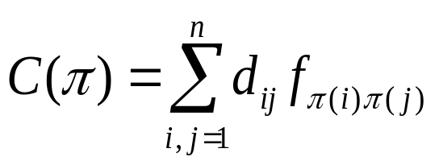
Quadratic Assignment Problem(QAP)
Problem is:
Assign n activities to n locations (campus and mall layout).
D= , , distance from location i to location j
F= , ,flow from activity h to activity k
Assignment is permutatio
Minimize:
• It’s NP hard

Slide 64
QAP Example
A
Locations
B
Facilities
?
C
biggest flow: A - B
How to assign facilities to locations ?
A
C
B
C
A
B
Higher cost
Lower cost

Slide 65


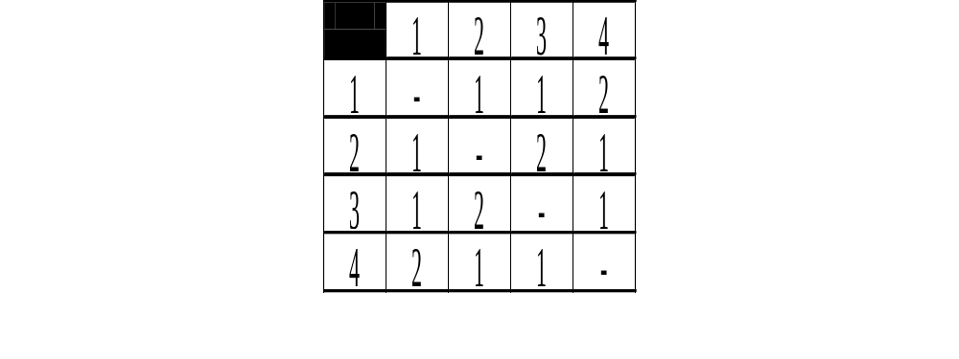
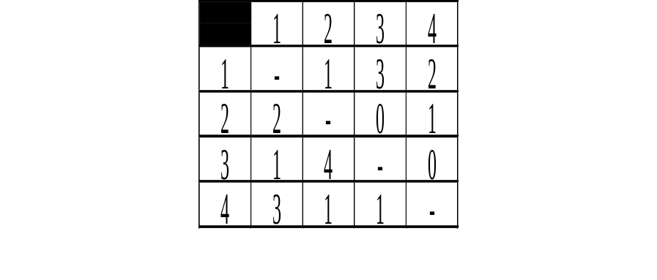
SIMPLIFIED CRAFT (QAP)
Simplification Assume all departments have equal size
Notation distance between locations i and j
travel frequency between departments k and h
1 if department k is assigned to location i
0 otherwise
Example
1
2
Location
4
2
3
4
1
3
Department („Facility“)
Distance*
Frequency*

Slide 66
Ant System (AS-QAP)
Constructive method:
step 1: choose a facility j
step 2: assign it to a location i
Characteristics:
– each ant leaves trace (pheromone) on the chosen couplings (i,j)
– assignment depends on the probability (function of pheromone trail and a heuristic information)
– already coupled locations and facilities are inhibited (Tabu list)

Slide 67
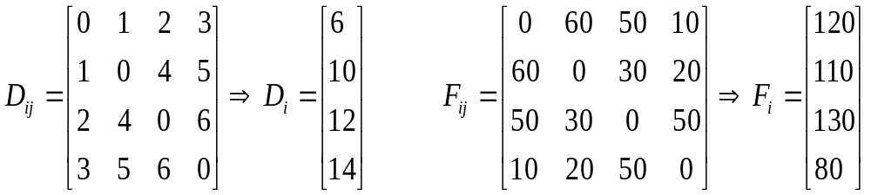


AS-QAP Heuristic information
Distance and Flow Potentials
 The coupling Matrix:
Ants choose the location according to the heuristic desirability “Potential goodness”

Slide 68


AS-QAP Constructing the Solution
The facilities are ranked in decreasing order of the flow potentials
Ant k assigns the facility i to location j with the probability given by:
where is the feasible Neighborhood of node i
When Ant k choose to assign facility j to location i it leave a substance, called trace “pheromone” on the coupling (i,j)
Repeated until the entire assignment is found

Slide 69



AS-QAP Pheromone Update
Pheromone trail update to all couplings:
is the amount of pheromone ant k puts on the coupling (i,j)
 Q...the amount of pheromone deposited by ant k

Slide 70
Hybrid Ant System For The QAP
Constructive algorithms often result in a poor solution quality compared to local search algorithms.
Repeating local searches from randomly generated initial solution results for most problems in a considerable gap to optimal soultion
Hybrid algorithms combining solution constructed by (artificial) ant “probabilistic constructive” with local search algorithms yield significantly improved solution.

Slide 71
Hybrid Ant System For The QAP (HAS-QAP)
HAS-QAP uses of the pheromone trails in a non-standard way.
used to modify an existing solution,
improve the ant’s solution using the local search algorithm.
Intensification and diversification mechanisms.

Slide 72
Hybrid Ant System For The QAP (HAS-QAP)
Generate m initial solutions, each one associated to one ant
Initialise the pheromone trail
For Imax iterations repeat
For each ant k = 1,..., m do
Modify ant k;s solution using the pheromone trail
Apply a local search to the modified solution
new starting solution to ant k using an intensification mechanism
End For
Update the pheromone trail
Apply a diversification mechanism
End For

Slide 73

HAS-QAP Intensification& diversification mechanisms
The intensification mechanism is activated when the best solution produced by the
search so far has been improved.
The diversification mechanism is activated if during the last S iterations no
improvement to the best generated solution is detected.
diversification
Intensification

Slide 74
HAS-QAP algorithms Performance
Comparisons with some of the best heuristics for the QAP have shown that HAS-QAP is among the best as far as real world, and structured problems are concerned.
The only competitor was shown to genetic-hybrid algorithm.
On random, and unstructured problems the performance of HAS-QAP was less competitive and tabu searches are still the best methods.
So far, the most interesting applications of ant colony optimization were limited to travelling salesman problems and quadratic assignment problems..

Slide 75
Section III
Network Routing
Vehicle Routing
Conclusions
Mr. Ahmad Elshamli

Slide 76
ROUTING IN COMM. NETWORKS
Routing task is performed by Routers.
Routers use “Routing Tables” to direct the data.
If your destination is node 5
next node to 3
6
4
3
1
5
2
2

Slide 77
ROUTING IN COMM. NETWORKS
Problem statement
Dynamic Routing
At any moment the pathway of a message must be as small as possible. (Traffic conditions and the structure of the network are constantly changing)
Load balancing
Distribute the changing load over the system and minimize lost calls.

Slide 78
ROUTING IN COMM. NETWORKS
Objective:
Minimize: Lost calls by avoiding congestion,
Minimize: Pathway
Dynamic Optimization Problem
+
Multi-Objectives Optimization Problem

Slide 79
ROUTING IN COMM. NETWORKS
Traditional way:
“Central Controllers”
Disadvantage:
Communication overhead.
Fault tolerance ~ Controller Failure.
Scalability
Dynamic ~ Uncertainty
Authority.

Slide 80
Algorithm I
Ant-based load balancing in telecommunication networks
(Schoonderwoerd, R. -1996)
Network has n nodes.
Each node has its Routing Table (pheromone table) {R_{i}[n-1][k]}
Initialize: equilibrium Routing table (all nodes have the same value or normalized random values)
Each node lunches {n-1} ants (agents) each to different destination.
Each ant select its next hop node proportionally to goodness of each neighbor node
routing table of the node that just the ant arrived to is updated as follows:
Reference: Schoonderwoerd, R. (1996) “Ant-based load balancing in telecommunication networks” Adapt. Behav. 5, 169-207

Slide 81



Algorithm I (cont.)
Increase the probability of the visited link by:
Decrease the probability of the others by :
Where
Reference: Schoonderwoerd, R. (1996) “Ant-based load balancing in telecommunication networks” Adapt. Behav. 5, 169-207

Slide 82


Algorithm I (cont.)
Example:
5
7
2
4
6
8
3
1
Reference: Schoonderwoerd, R. (1996) “Ant-based load balancing in telecommunication networks” Adapt. Behav. 5, 169-207

Slide 83




Algorithm I (cont.)
Example:
Routing table @ node 1
2
4
1
3
Reference: Schoonderwoerd, R. (1996) “Ant-based load balancing in telecommunication networks” Adapt. Behav. 5, 169-207

Slide 84

Algorithm I (cont.)
The mean percentages (ten experiments each) and standard deviations of call failures for changed call probabilities
Reference: Schoonderwoerd, R. (1996) “Ant-based load balancing in telecommunication networks” Adapt. Behav. 5, 169-207

Slide 85
Algorithm II
AntNet
(Di Caro & Dorigo - 1997)
r⁺, r⁻
r⁺, r⁻
B-ANT
B-ANT
B-ANT
1
2
3
F-ANT
F-ANT
F-ANT
F-Ants also measure the quality of the trip (# nodes, Node Statistics)
imp
VERY GOOD RESULTS, But it Generates bigger consumption of the network resources.
Reference: Schoonderwoerd, R. (1996) “Ant-based load balancing in telecommunication networks” Adapt. Behav. 5, 169-207

Slide 86
Vehicle Routing Problem with Time Windows (VRPTW)
N customers are to be visited by K vehicles
Given
Depots (number, location)
Vehicles (capacity, costs, time to leave, time on road..)
Customers (demands,time windows, priority,...)
Route Information (maximum route time or distance, cost on the route)

Slide 87

Vehicle Routing Problem with Time Windows (VRPTW)
Objective Functions to Minimize
Total travel distance
Total travel time
Number of vehicles
Subject to:
Vehicles ( # ,Capacity,time on road,trip length)
Depots (Numbers)
Customers (Demands,time windows)

Slide 88
Vehicle Routing Problem with Time Windows (VRPTW)
Relation with TSP?!
[10:00-11:15]
[11:00-11:30]
[8:00-9:00]
[10:00-11:45]
[8:30-10:30]
[8:00-12:30]
[8:15-9:30]
Depots
Depot
[10:15-11:45]

Slide 89
VRP “Simple Algorithm”
- Place ants on depots (Depots # = Vehicle #).
- Probabilistic choice
~ (1/distance, d_{i}, Q)
~ amount of pheromone
- If all unvisited customer lead to a unfeasible solution:
Select depot as your next customer.
- Improve by local search.
- Only best ants update pheromone trial.

Slide 90




Multiple ACS For VRPTW
MAC-VRPTW
Multi-objectives
ACS-VEI
(Min. Vehicles number)
ACS-TIME
(Min. Travel time)
Single objective
Gambardella L.M., Taillard 12. (1999), “Multiple ant colony system for VRPTW”

Slide 91
Parallel implementation
Parallelism at the level of ants.
  Ants works in parallel to find a solution.
Parallelism at the level of data.
  Ants working for sub-problems
Functional Parallelism.
  Ant_generation_activity()
  Pheromone_evaporation()
  Daemons_actions()
Good choice

Slide 92
Similarities with other Opt. Technique
Populations,Elitism ~ GA
Probabilistic,RANDOM ~ GRASP
Constructive ~ GRASP
Heuristic info, Memory ~ TS

Slide 93
Design Choices
Number of ants.
Balance of exploration and exploitation
Combination with other heuristics techniques
When are pheromones updated?
Which ants should update the pheromone.?
Termination Criteria

Slide 94



Ongoing Projects
DYVO: ACO for vehicle routing
MOSCA: Dynamic and time dependent VRP
Ant@ptima: Research applications

Slide 95
Conclusions
ACO is a recently proposed metaheuristic approach for solving hard combinatorial optimization problems.
Artificial ants implement a randomized construction heuristic which makes probabilistic decisions.
The a cumulated search experience is taken into account by the adaptation of the pheromone trail.
ACO Shows great performance with the “ill-structured” problems like network routing.
In ACO Local search is extremely important to obtain good results.

Slide 96
References
Dorigo M. and G. Di Caro (1999). The Ant Colony Optimization Meta-Heuristic. In D. Corne, M. Dorigo and F. Glover, editors, New Ideas in Optimization, McGraw-Hill, 11-32.
M. Dorigo and L. M. Gambardella. Ant colonies for the traveling salesman problem. BioSystems, 43:73–81, 1997.
M. Dorigo and L. M. Gambardella. Ant Colony System: A cooperative learning approach to the traveling salesman problem. IEEE Transactions on Evolutionary Computation, 1(1):53–66, 1997.
G. Di Caro and M. Dorigo. Mobile agents for adaptive routing. In H. El-Rewini, editor, Proceedings of the 31st International Conference on System Sciences (HICSS-31), pages 74–83. IEEE Computer Society Press, Los Alamitos, CA, 1998.
M. Dorigo, V. Maniezzo, and A. Colorni. The Ant System: An autocatalytic optimizing process. Technical Report 91-016 Revised, Dipartimento di Elettronica,Politecnico di Milano, Italy, 1991.
L. M. Gambardella, ` E. D. Taillard, and G. Agazzi. MACS-VRPTW: A multiple ant colony system for vehicle routing problems with time windows. In D. Corne, M. Dorigo, and F. Glover, editors, New Ideas in Optimization, pages 63–76. McGraw Hill, London, UK, 1999.
L. M. Gambardella, ` E. D. Taillard, and M. Dorigo. Ant colonies for the quadratic assignment problem. Journal of the Operational Research Society,50(2):167–176, 1999.
V. Maniezzo and A. Colorni. The Ant System applied to the quadratic assignment problem. IEEE Transactions on Data and Knowledge Engineering, 11(5):769–778, 1999.
Gambardella L. M., E. Taillard and M. Dorigo (1999). Ant Colonies for the Quadratic Assignment Problem. Journal of the Operational Research Society, 50:167-176.

Slide 97
Thank you

